Slide 1
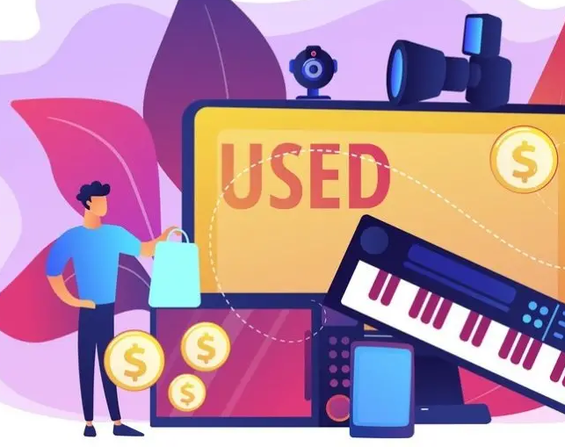
Second Hand Market
Team – MuchBetterThanOpenAI
Li Ning
Yirui Song
Junyi Zhang
Qingyu Zhou

Slide 2

Requirements Fulfilled
Used JavaFX
Interface
Class Definition
Lists
Interitance
Maps

Slide 3
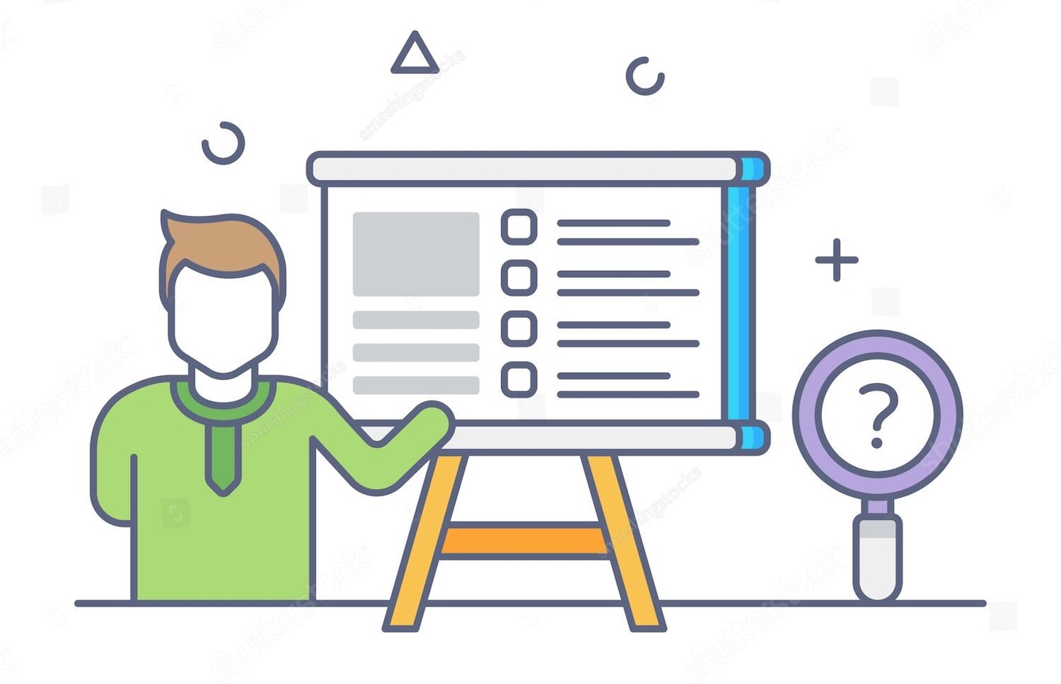
Problem Description
Northeastern University currently lacks a second-hand trading platform, creating a gap for students and staff who need a reliable way to buy and sell used goods.
To address this issue, we have developed a platform that allows anyone with a used goods in our platform.
The problem we aim to address is the exclusion of individuals from the second-hand market due to a lack of accessible and reliable platforms.
Developing such a platform will provide a secure, convenient marketplace, promoting sustainability, affordability, and a stronger campus connection.

Slide 4
Analysis
Northeastern University currently lacks a dedicated second-hand trading platform. However, many other universities already have their own second-hand marketplaces.
Students are left with no choice but to use external platforms for trading, where reliability cannot be guaranteed.
Our application provides users with the ease to sell or buy second-hand goods.
Our platform ensures reliability and security for every transaction, guaranteeing the safety of students' trades.

Slide 5
System Design
The application uses the Model-View-Controller (MVC) design pattern to structure its applications
Business layer- Model classes
Middle layer- Controller classes
User interfaces

Slide 6
Work Assignment
 | Qingyu Zhou | Junyi Zhang | Li Ning | Yirui Song
UI | Home Add items | Login Product Details Payment Interface |  | Register
Controller / Service | Full stack of Homep age and Add items page | Product Sevice & Control FileLoader controller | Product Detail Sevice & Control Payment Sevice & Control | Register Control & Service, Login Backend
Document | Report | Report | Report | Report

Slide 7
Conclusion and Future work
This application is a basic application. In future, we can implement different types of user and implement message feature.
The advantage of this type of application is anyone can sell and buy their used goods, and there is no need for a third-party to manage.
The advantage of this type of application is anyone can sell and buy their used goods, and there is no need for a third-party to manage.
The Project for now is limited to only one user. If more time we would develop C/S model.

Slide 8

Thank You!

